Slide 1
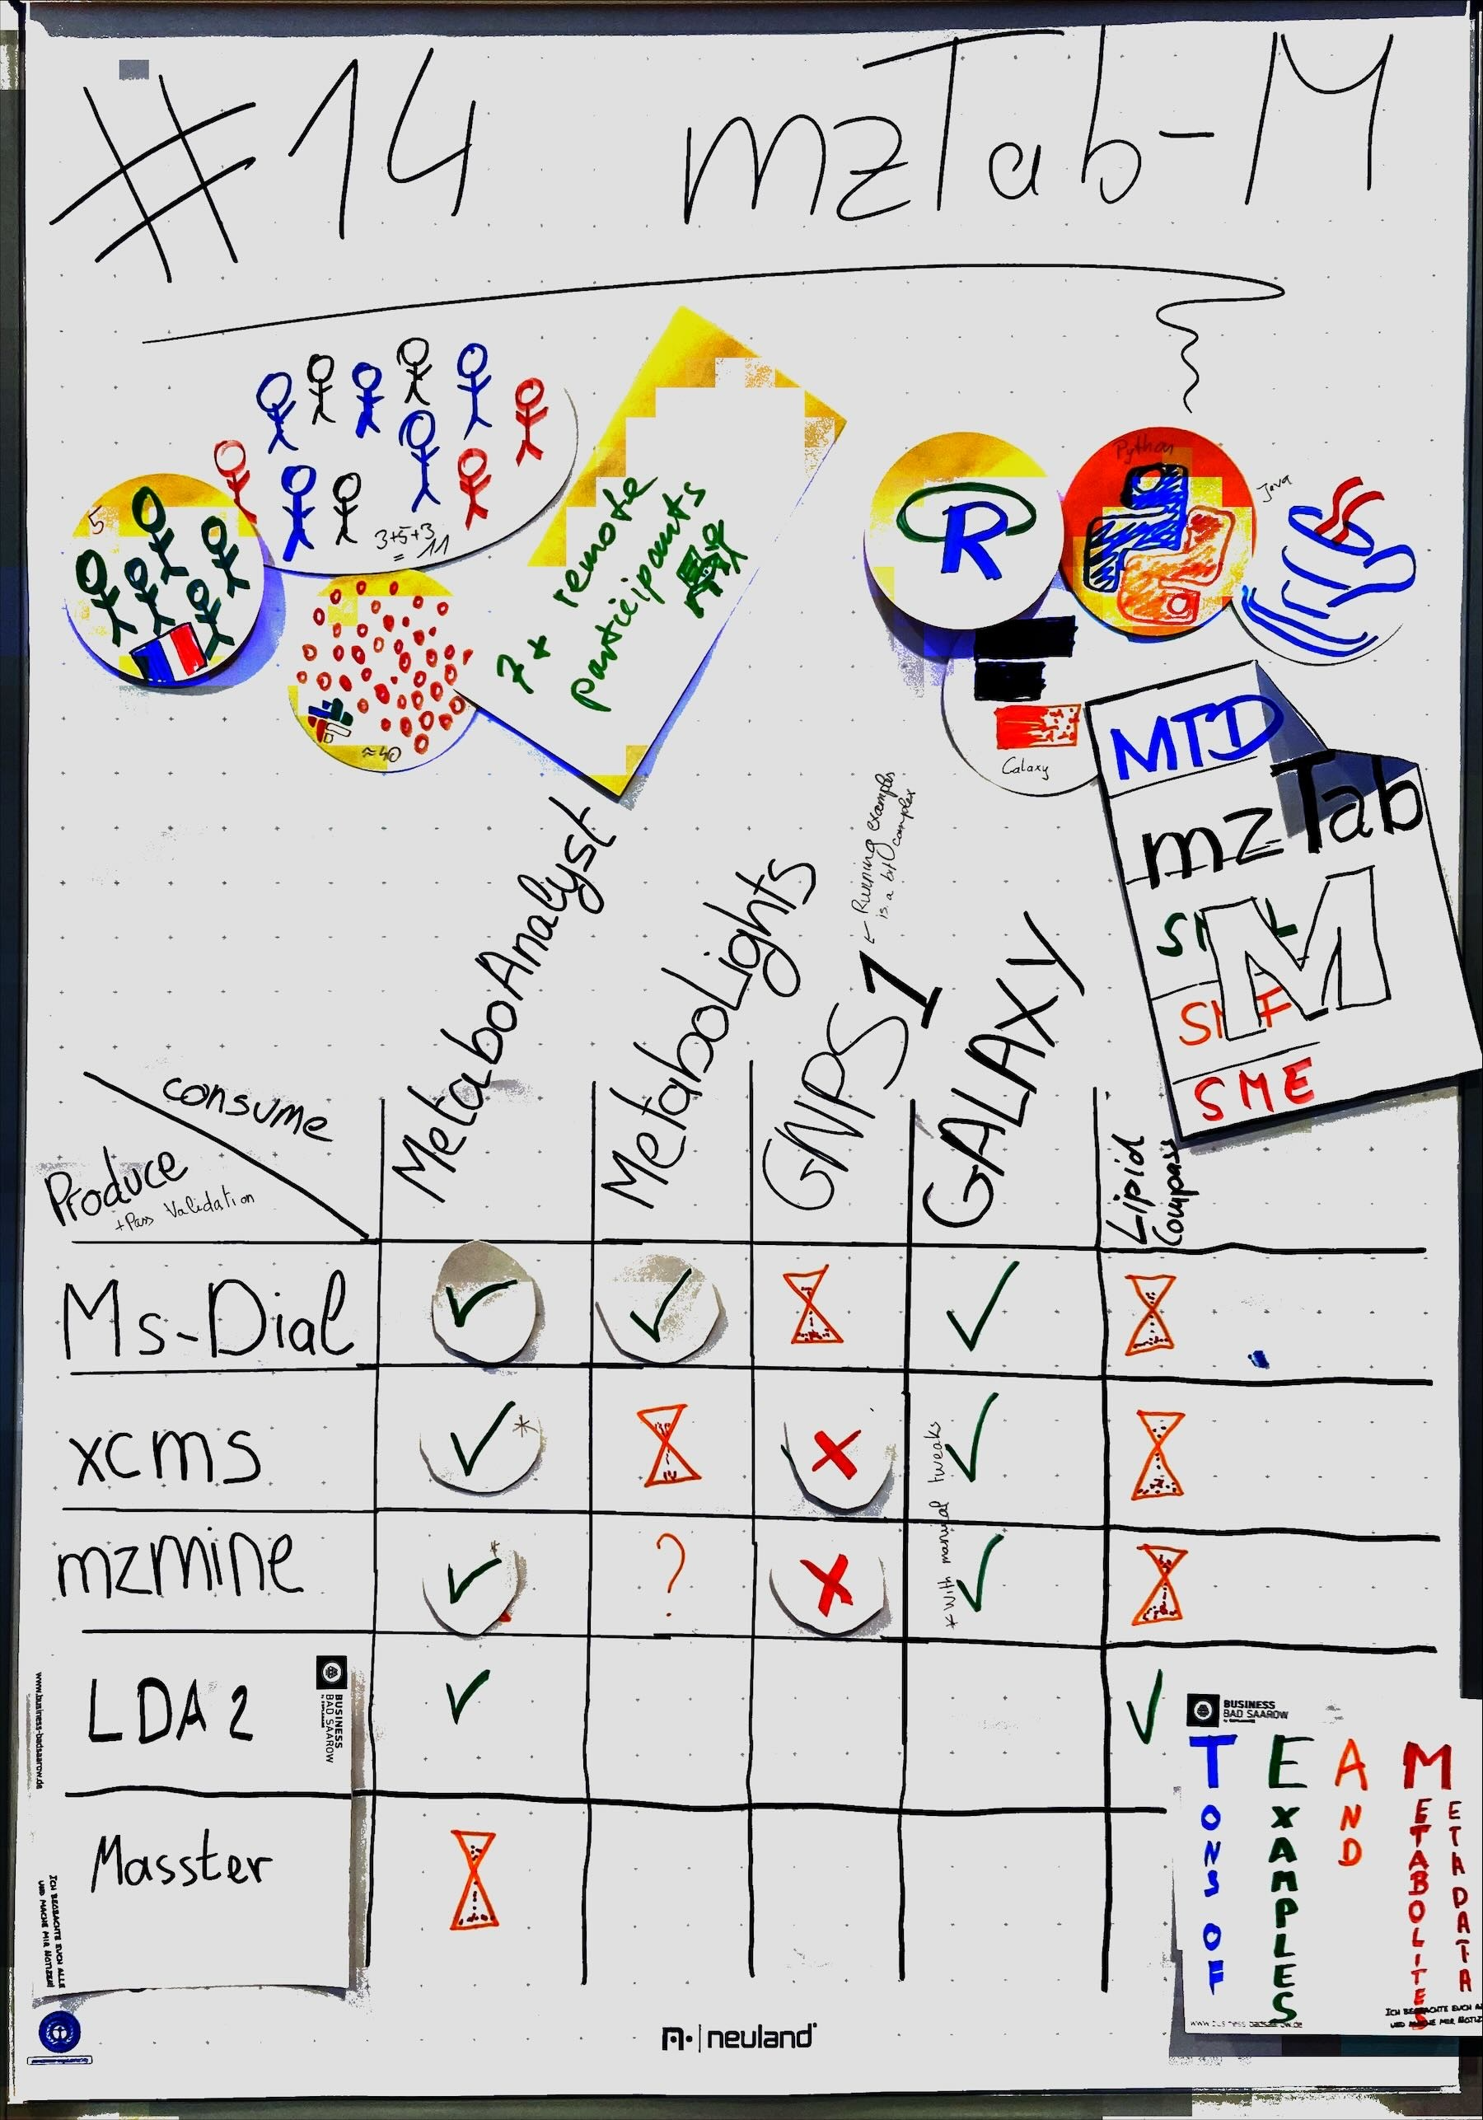
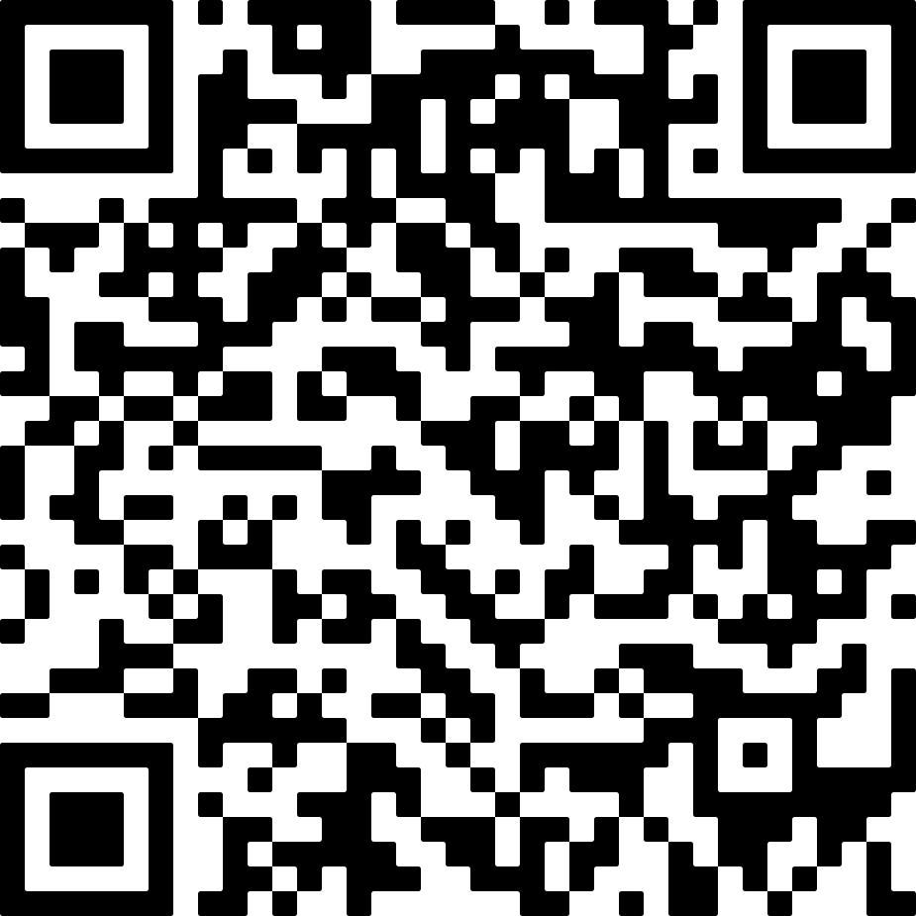

Towards mzTab-M 2.1 – Evolving the HUPO-PSI standard format and ecosystem for reporting of small molecule mass spectrometry results
Nils Hoffmann¹; Philippine Louail²; Bo Burla³; Yasin El Abiead⁴; Eoin Fahy⁵; Franck Giacomoni⁶; Nicolas Guilhot⁶; Jürgen Hartler⁷; Steffen Heuckeroth⁸; Ibrahim Karaman⁹; Janik Kokot¹⁰; Leonida M. Lamp⁷; Christian Müller¹¹; Steffen Neumann¹²; Kozo Nishida¹³; Nils Paulhe⁶; Thomas Payne⁹; Mélanie Pétéra⁶; Johannes Rainer²; Adriano Rutz¹⁴; Faustine Souc⁶; Hiroshi Tsugawa¹⁵; Juan Antonio Vizcaíno⁹; Sofie Weinkouff¹¹; Ozgur Yurekten⁹; Nicola Zamboni¹⁴
¹Forschungszentrum Jülich GmbH, Bielefeld, Germany; ²Institute for Biomedicine, Eurac Research, Bolzano, Italy; ³Singapore Lipidomics Incubator, Life Sciences Institute, NUS, Singapore; ⁴Univ. of Natural Resources and Life Sciences Vienna, Dept. of Chemistry, Vienna, Austria; ⁵Dept. of Bioengineering, University of California San Diego, La Jolla, CA, USA; ⁶Université Clermont Auvergne, INRAE, UNH, MetaboHUB Clermont, Clermont-Ferrand, France; ⁷Institute of Pharmaceutical Sciences, University of Graz, Graz, Austria; ⁸mzio GmbH, Bremen, Germany; ⁹EMBL-EBI, Hinxton, Cambridge, United Kingdom; ¹⁰Institute of Human Genetics, Medical University of Innsbruck, Innsbruck, Austria; ¹¹Bruker Daltonics GmbH, Bremen, Germany; ¹²Leibniz Institute of Plant Biochemistry, Halle, Germany; ¹³RIKEN Center for Biosystems Dynamics Research, Kobe, Japan; ¹⁴Institute of Molecular Systems Biology, ETH Zurich, Switzerland; ¹⁵Dept. of Biotechnology and Life Science, Tokyo Univ. of Agriculture and Technology, Tokyo, Japan
The mzTab format family was developed by the Proteomics Standards Initiative (PSI) to capture the design and both qualitative and quantitative results of mass spectrometry experiments
mzTab 1.0 for Proteomics: adopted in some tools and as submission format for EMBL-EBI PRIDE repository (2014)¹
mzTab-M 2.0: new implementation for Metabolomics tools and data repositories (published 2019)²
Uses ontologies for metadata and experimental outcomes (processed results) and for semantic validation
Interoperability between all producers and consumers was not systematically evaluated
Limited community and vendor uptake due to limited repository support
Through different joint activities, we are updating mzTab-M to version 2.1 and at the same time reaching out to software developers (academic and commercial) to support implementation of mzTab-M
INTRODUCTION
mzTab-M 2.1 SOFTWARE ECOSYSTEM ROADMAP
The mzTab-M 2.1 draft remains largely backward-compatible with 2.0 while adding new features and resolving several issues.
Machine-Readable & Agent-Friendly
Semantic enrichment through use of CV parameters
Agentic-AI skills to create mzTab-M files
Study Variable Groups
Added study variable groups for complex experimental designs
Interoperability with other HUPO-PSI Standards
Scan reference on evidence level to mzMLs³
Integration of Universal Spectrum Identifier (USI) for mass spectra⁴
Referencing of mzSpecLib mass spectral libraries and peak annotation format⁵
Referencing of mzQC for mass spectral quality control data⁶
Protocol Sections
Sample processing protocols
Chromatography details
Mass spectrometry acquisition parameters
Improved Validation
Enhanced semantic validation profiles and interoperability tests
Improved Documentation
Updated website structure for users and developers
New examples and updated links to implementations
mzTab-M 2.1 DRAFT
Producers
Libraries
Consumers
LDA2
Java (jmzTab-M)
Python (pymztab-m)
R (RmzTabM)
MetaboAnalyst
MS-DIAL
Galaxy Workflows
xcms
MetabolomicsHub
RforMassSpectrometry
MetaboLights
mzmine
GNPS
MetaboScape
LipidCompass
MetaboLights
MassBank
...
...
Implementation Efforts
Through regular group meetings and (virtual) hackathons, tool and database & repository developers receive direct development support to ensure mzTab-M standard compliance
2014
2019
2025
2026+
mzTab 1.0
mzTab-M 2.0
BioHackathon
mzTab-M 2.1
mzTab-M 2.1 is a working draft. Implementation status varies by tool — see developer pages for current support.
FORMAT STRUCTURE & VALIDATION
INTEROPERABILITY EXERCISE – KEY RESULTS
Established interoperability between multiple producers and consumers of mzTab-M
Collected broad test collection of mzTab-M files from diverse sources
Tested compatibility across tool combinations
Reported errors and contributed fixes upstream
Issues Identified
Examples missing or not sufficient to demonstrate complex setups
Inconsistencies in how tools represent study variables and metadata, need to enable iterative refinement of files in workflows
Missing protocol information for sample processing, chromatography, and MS details
Integration with other tools and resources
ELIXIR BIOHACKATHON EUROPE 2025
References
Griss et al. (2014) MCP, 10.1074/mcp.O113.036681 (mzTab 1.0)
Hoffmann et al. (2019) Anal. Chem., 10.1021/acs.analchem.8b04310 (mzTab-M 2.0)
Martens et al. (2010) MCP, 10.1074/mcp.R110.000133 (mzML)
Deutsch et al. (2021) Nat. Methods., 10.1038/s41592-021-01184-6 (USI)
Klein et al. (2024) Anal. Chem., 10.1021/acs.analchem.4c04091 (mzSpecLib & mzPAF)
Bielow et al. (2024) JASMS, 10.1021/jasms.4c00174 (mzQC)
Acknowledgments
We would like to thank the following people for their help, support and feedback: Luca De Martino, Fiona Hui, Jeff Xia, Eisuke Hayakawa, Mingxun Wang, Pieter Dorrestein, Robin Schmid, Tomas Pluskal, Helge Hecht, Denise Slenter, Nikolas Kessler, Sagar Gore, Anna Eggers, Norman Storz, Guillaume Patoine, Johan Gustafsson, Michał Burdukiewicz. This work was carried out as part of the HUPO-PSI Metabolomics working group activities. It was further supported as project 14 “Proteomics and Metabolomics File Format Interoperability Fest” at the BioHackathon Europe 2025, Berlin, funded by ELIXIR Europe.
This work was supported by the German Network for Bioinformatics Infrastructure (de.NBI) and ELIXIR-DE (Forschungszentrum Jülich and W-de.NBI-006). The authors declare no competing financial interest.
Resources
HUPO-PSI mzTab-M specification: github.com/HUPO-PSI/mzTab-M
Documentation Hub: hupo-psi.github.io/mzTab-M
MetaboLights: www.ebi.ac.uk/metabolights
MetabolomicsHub: www.metabolomicshub.org/
Related Posters
TP 319, WP 447, WP 520
REFERENCES & ACKNOWLEDGMENTS
Metadata
Features
schema-backed, (de)serialization from/into JSON or TSV formats
CV-controlled metadata, contacts, samples, assays, MS-runs, study variables, quantification
MS features, e.g. m/z, RT, CCS
Identification evidence, e.g. DB hits, similarities, additional info, reference MS scans in run (mzML)
Summary
Features
Evidence
Semantic Validation
mzTab-M file
Custom CV rules mapping file
Semantic Validator
Ontology Lookup Service (EBI OLS)
Metadata Declares CVs
Defines allowed CVs
CV Mapping Rules
Paths to terms in mzTab-M
Combination Logic
CV Terms
Constraints
Check rule requirement level
Select mzTab-M elements
Check term constraints vs OLS & rule
Return validation result
Receives term in mzTab-M element
Receives CV
Return true if term is child of terms in rule
Return false otherwise
Summary
Features
Evidence
CV: Controlled Vocabulary
Validation Messages

